Slide 1
Heart Disease
Ryan Hernandez
Wilnelia Aviles

Slide 2
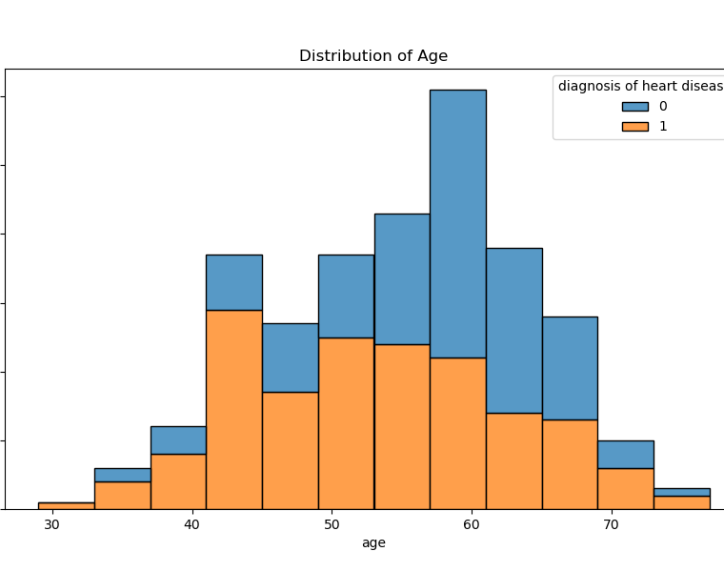
Distribution of Age
Here is the distribution of age along as the result of diagnosis of heart disease. General idea of dataset numbers. Shortly after age 40, we notice a spike in heart disease diagnosis.

Slide 3
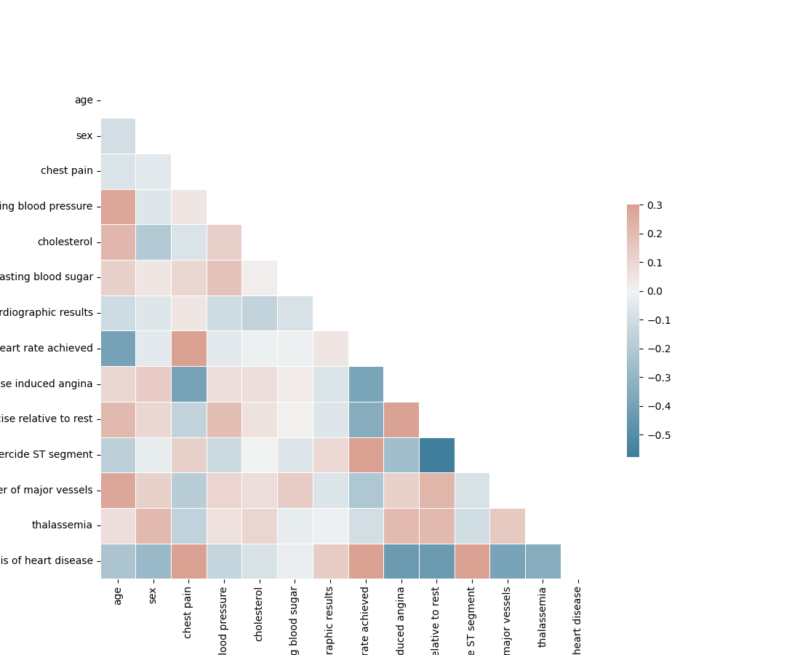
Heatmap
Here we can observe the relevance of each symptom correlating with each other. Closer to 1 means the symptoms show correlation and closer to -1 the symptoms show no correlation.

Slide 4
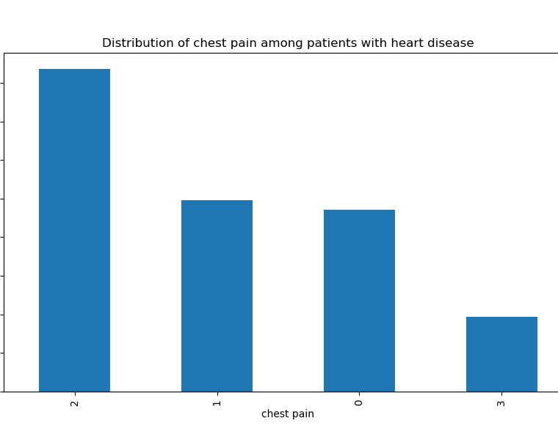
Chest Pain
Chest pain ranges from 0-3. 0=typical angina, 1=atypical angina, 2=non-anginal pain, 3=asymptomatic. In the graph 2 is largely separated by the other chest pains. So, patients that are diagnosed with heart disease, most likely experience the chest pain type 2.

Slide 5
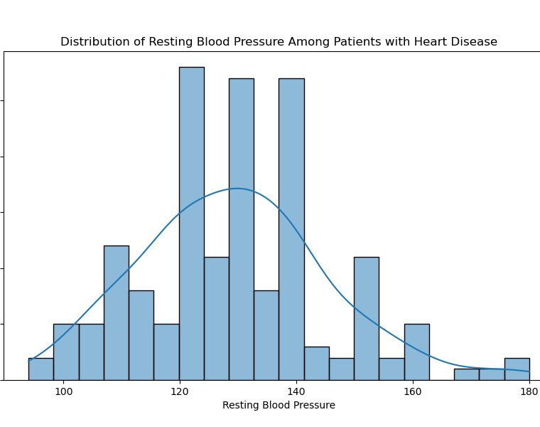
Resting Blood Pressure
Normal blood pressure is =<120. Just one of the many symptoms to keep an eye out for developing heart disease.

Slide 6
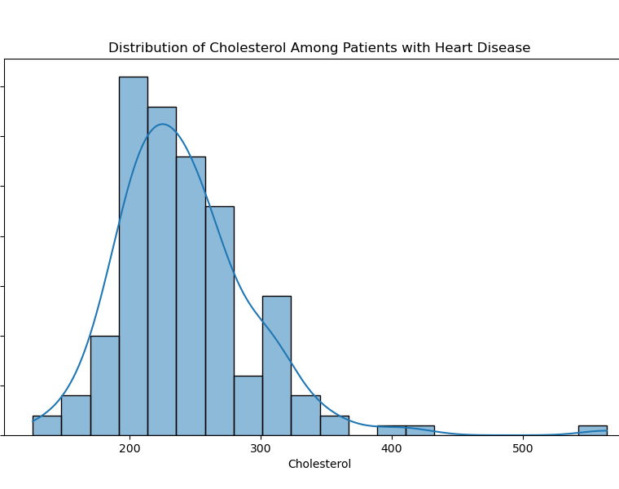
Cholesterol Levels
Anything below 200mg is normal. In the graph we notice after 200, there is a higher chance to developing heart disease.

Slide 7
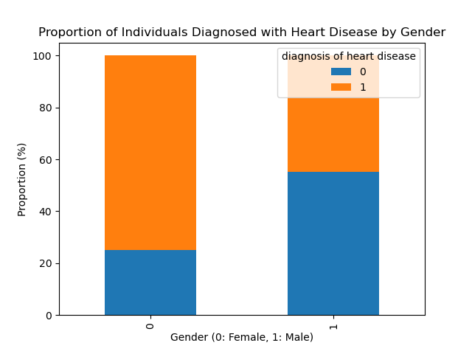
Gender
Women are more prone to developing heart disease than men. Also another interesting note is that women are more likely to be misdiagnosed than men. A big reason is because of hormonal fluctuations.

Slide 8
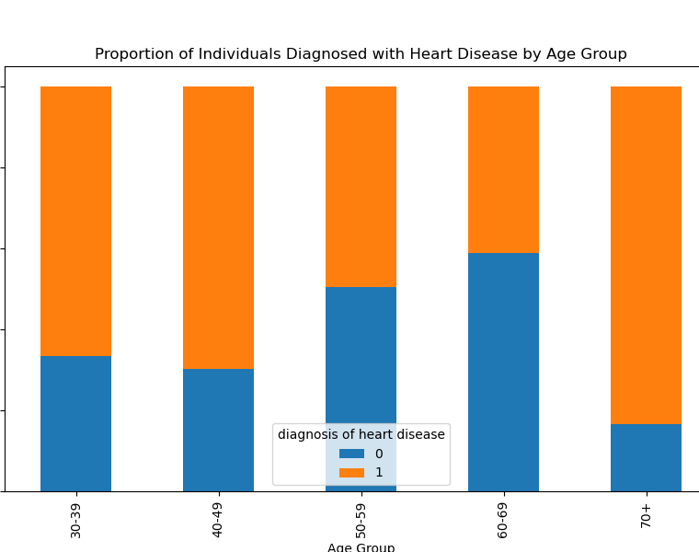
Age Group
Age is also a significant factor to developing heart disease. In this graph we see that the age bracket of ages 60-69 has the highest diagnosis of heart disease.

